Slide 1
Introduction to Image Analysis
Measurements in time sequences & tracking
Robert Haase, Benoit Lombardot
Contents
Image correction
Visualisation
Measurements in time sequences
Tracking

Slide 2
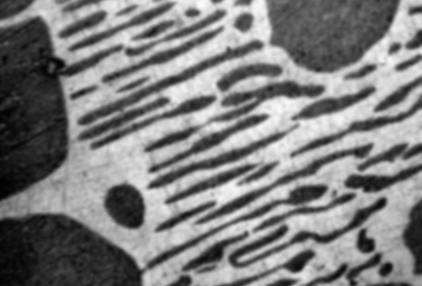
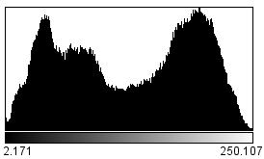
Quiz
Given that image and the corresponding histogram:
Which threshold would you choose to differentiate black objects from the from the white background?
12
123
234

Slide 3
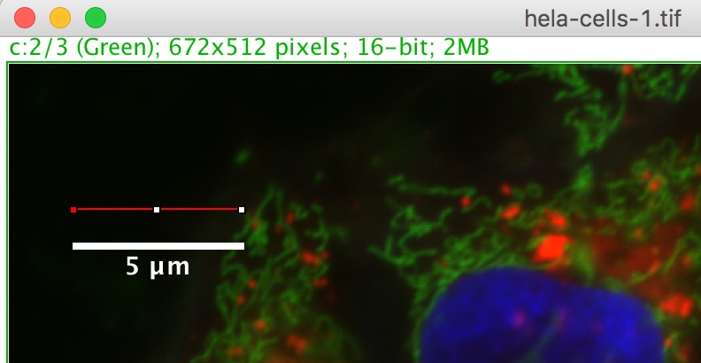
Quiz
I was just drawing this red line along my scale bar.
What’s the images pixel size?
0.5 µm
0.05 µm
0.01 µm

Slide 4
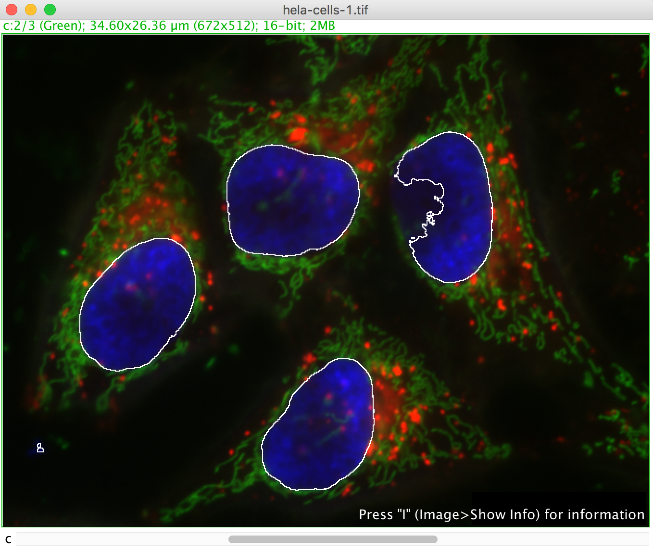
Quiz
If I measure the signal in the white ROI, what will be my measurement if I press the M key?
Signal in the green channel
Signal in the blue channel
Signal in the red channel

Slide 5
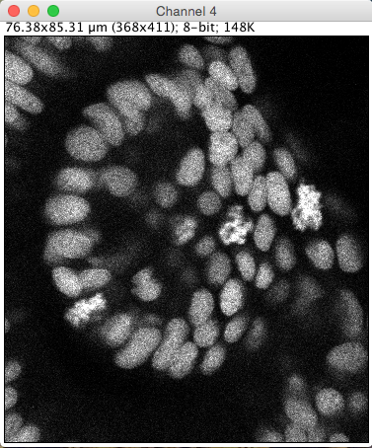
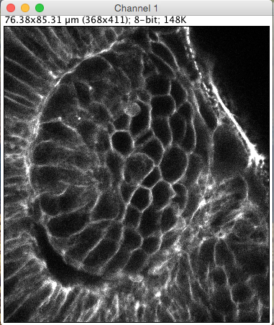
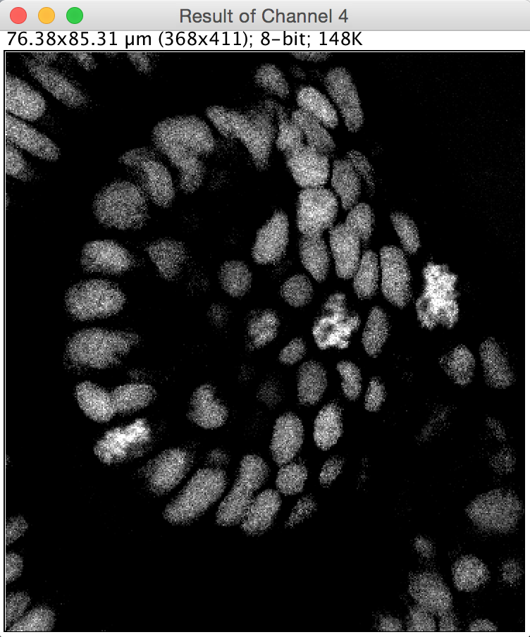



Quiz
What operation do we need to apply to get this result?
?
$$+$$
$$−$$
$$/$$

Slide 6
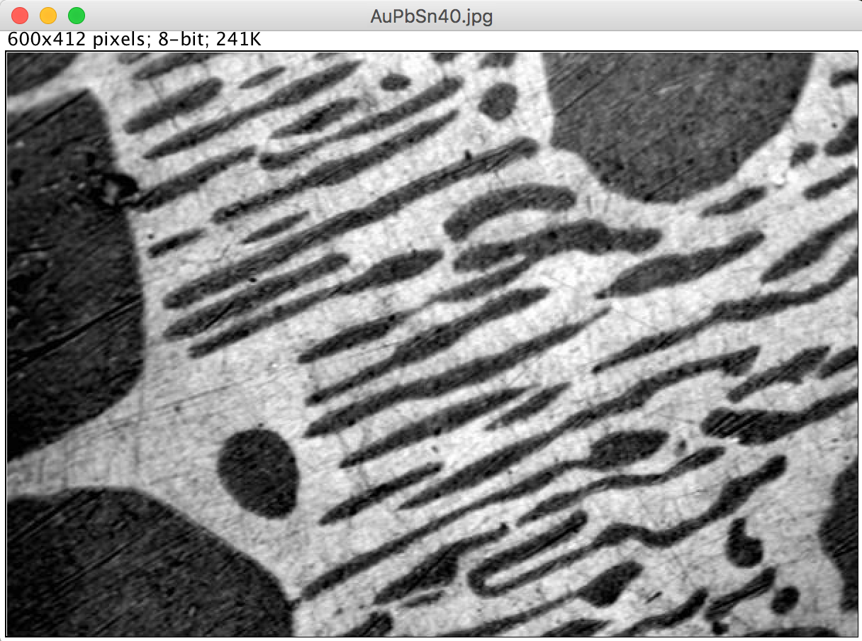
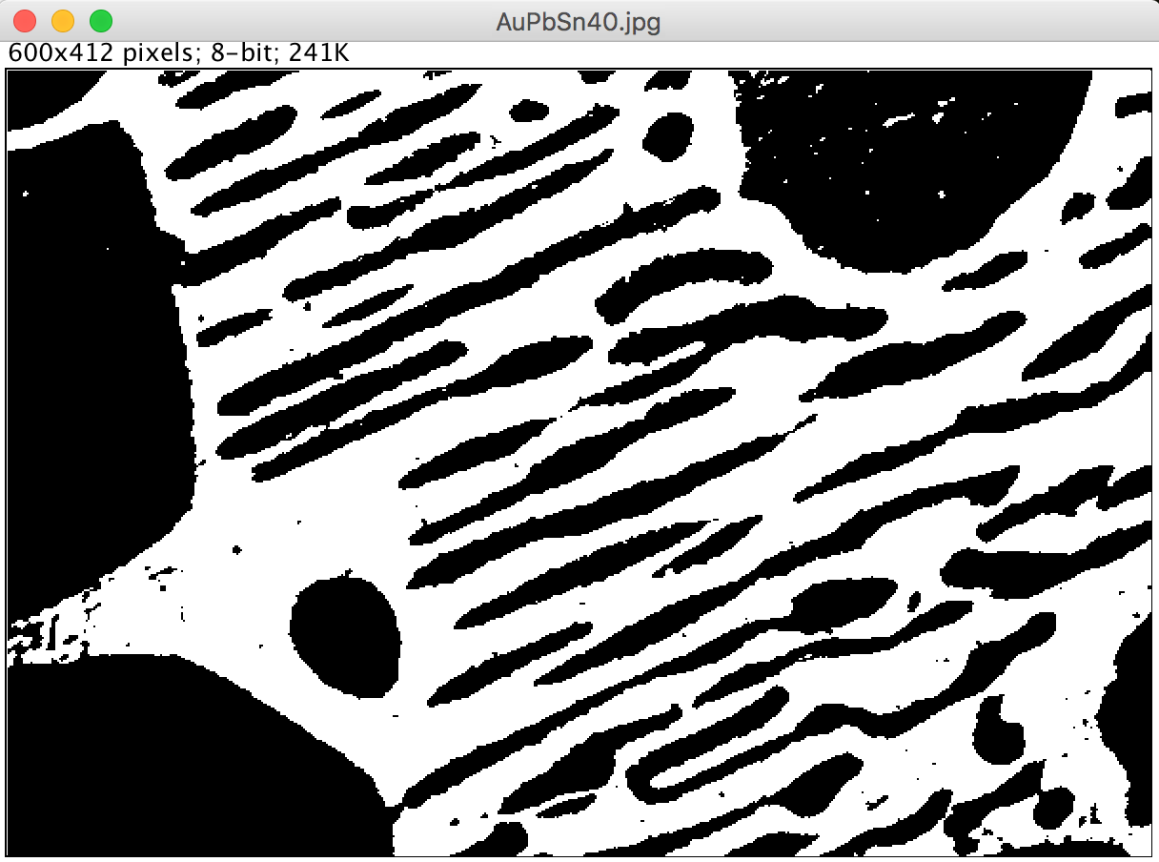
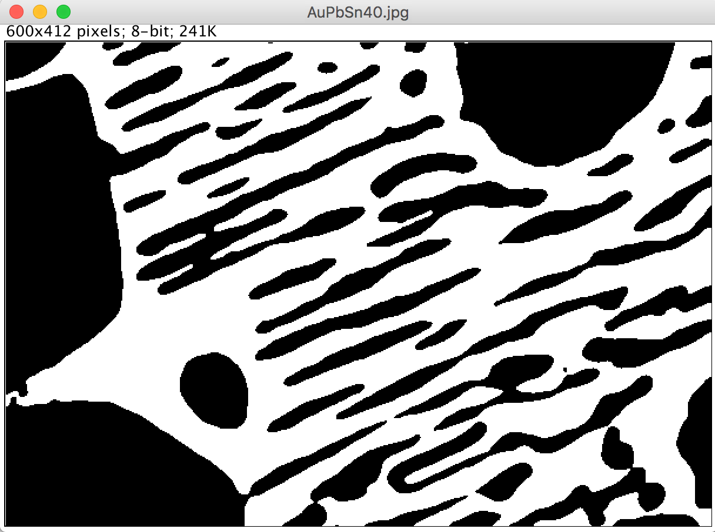
Quiz
What could be done to improve the threshold result?
X + Thresholding
Thresholding
Draw a ROI
Gaussian blur
Subtract background

Slide 7
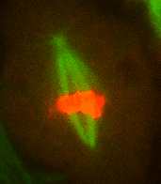
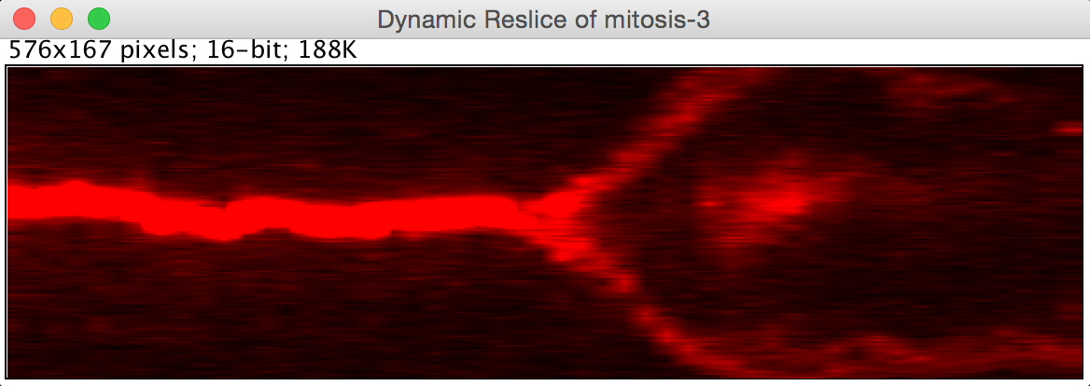
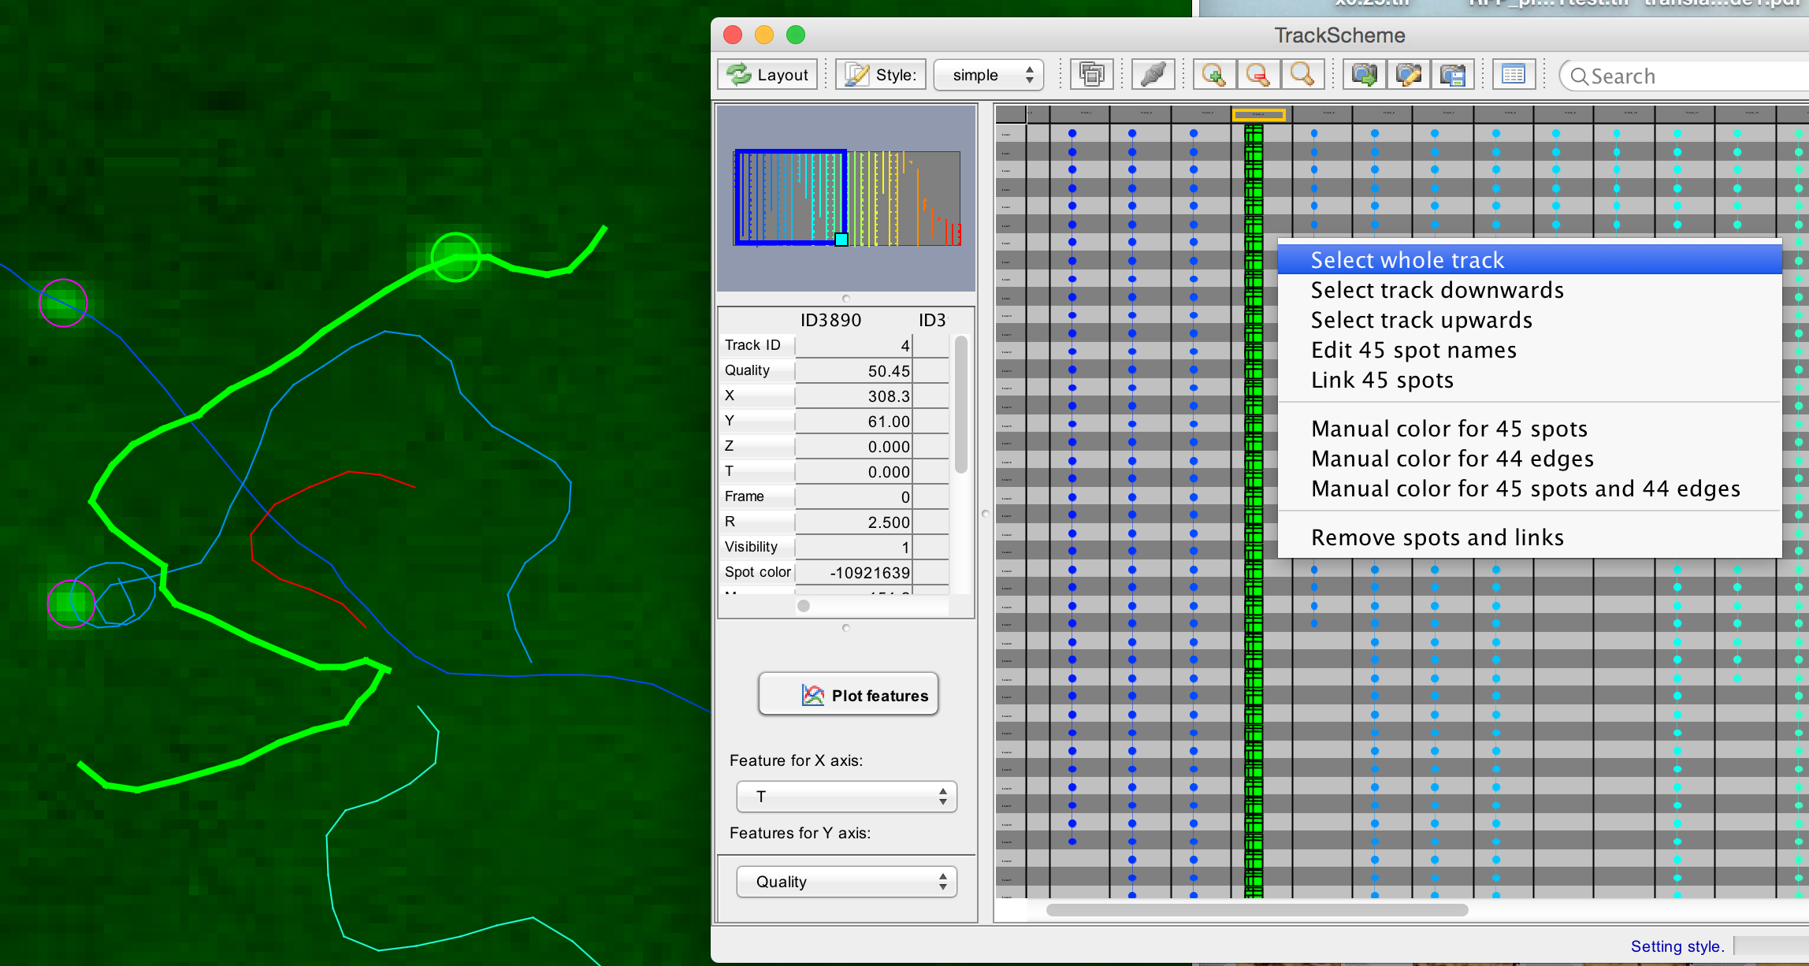
Overview
Measurements in time sequences
Image correction
Image registration
Motion correction
Bleaching correction
Visualisation
Kymography
How to build kymographs
How to interpret kymographs
Visualisation of time sequences in Imaris (Demo)
Tracking
Introduction / Theory
Single particle tracking
Trackmate demo
Exercise

Slide 8
Definition: Registration
Measurements in time sequences
“Image registration is the process of transforming different sets of data into one coordinate system.”
Source: Wikipedia
y
y
y
x
x
x
Technically, that means finding corresponding structures and
determining the optimal transformation to correct the misalignment of the images and apply the transformation.

Slide 9
Terminology: Naming images
Measurements in time sequences
Most commonly, one image is moved/rotated/… to match it in the coordinate system of the other image.
y
x
Reference,
source or
fixed image
Target,
subject or
moving image

Slide 10
Registration strategies
Measurements in time sequences
Feature-based
Intensity-based
versus
Mean squared error of pixel values
MSE = 2000
MSE = 1900
System of linear equations
Optimisation
MSE = 500
MSE = 0

Slide 11
Misalignments
Measurements in time sequences
There are many facets of misalignments
The less we observe, the easier is the correction
aligned image
translation
rotation
isometric scaling
scaling
shearing

Slide 12
Global transformations
Measurements in time sequences
fixed
moving
Translation only
Translation
+ Rotation
Rigid transformation
Translation
+ Rotation
+ Isometric scaling
Geometric similar transformation
Translation
+ Rotation
+ scaling
[+shearing]
Affine transformation

Slide 13
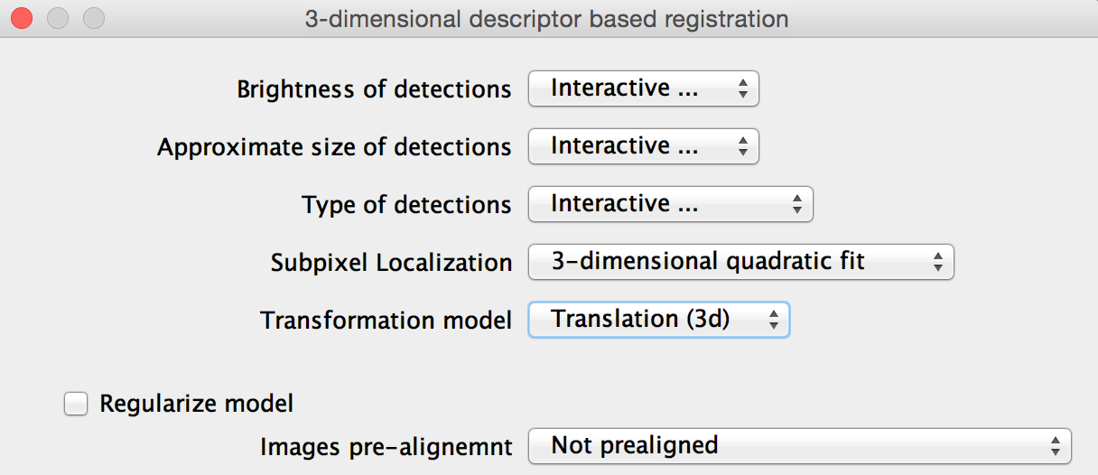
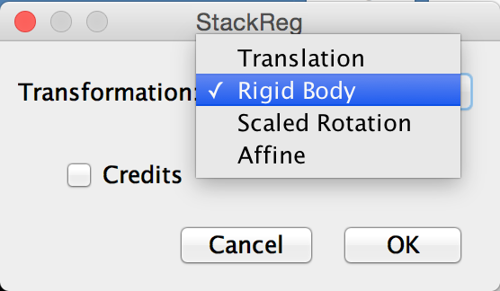
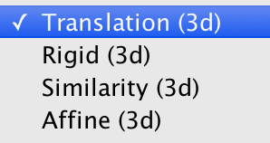
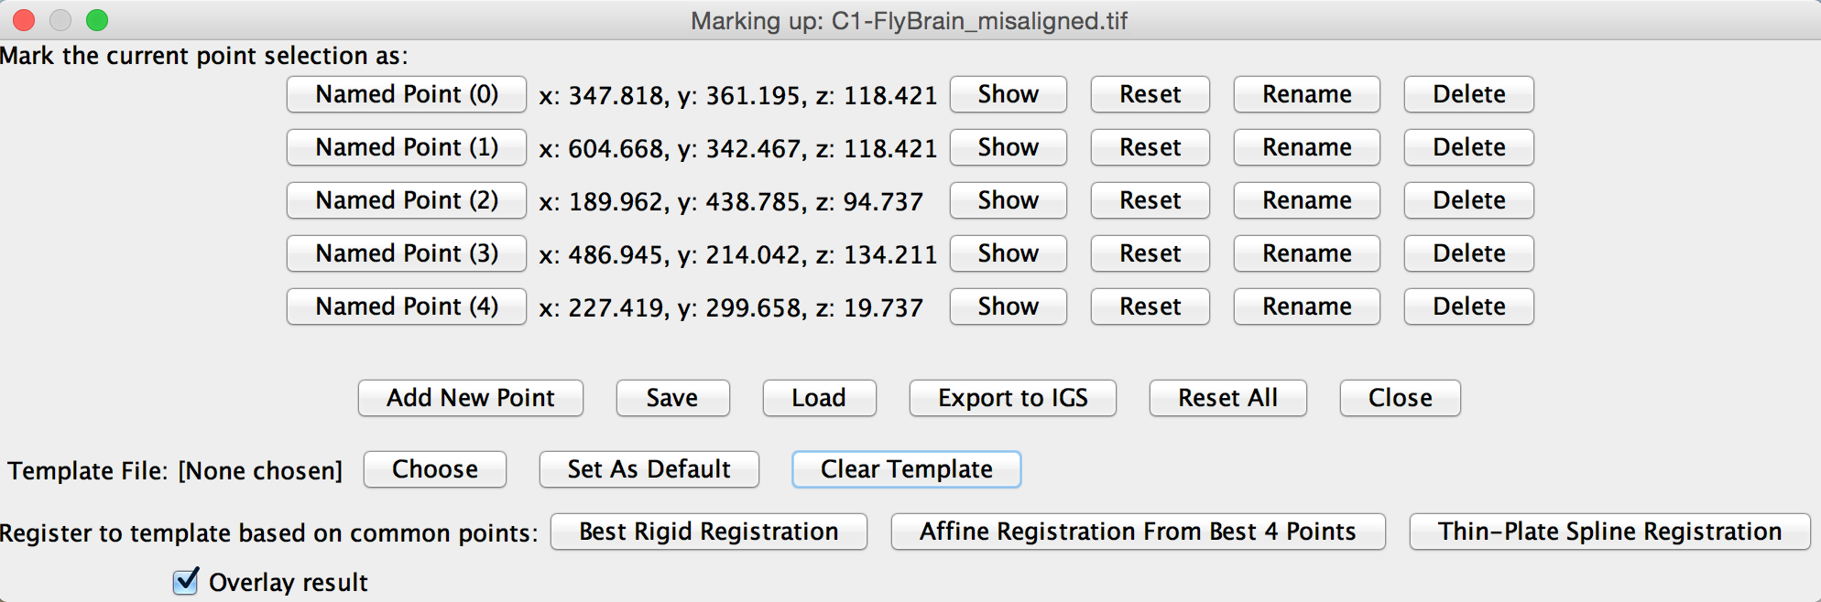
Global transformations
Terminology
These terms are variously used in registration software

Slide 14
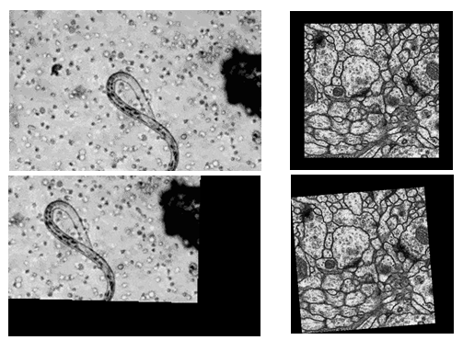
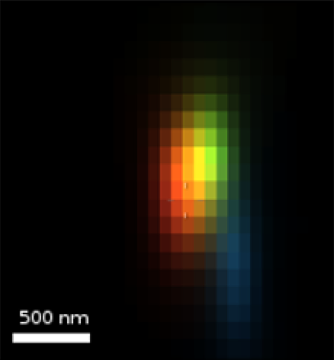
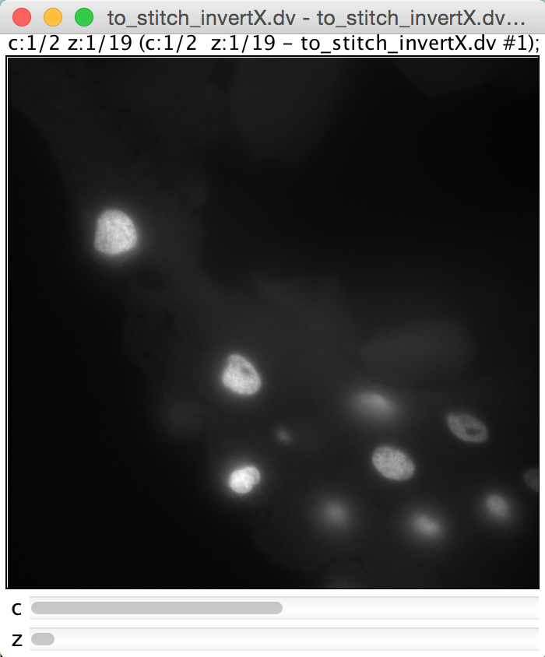
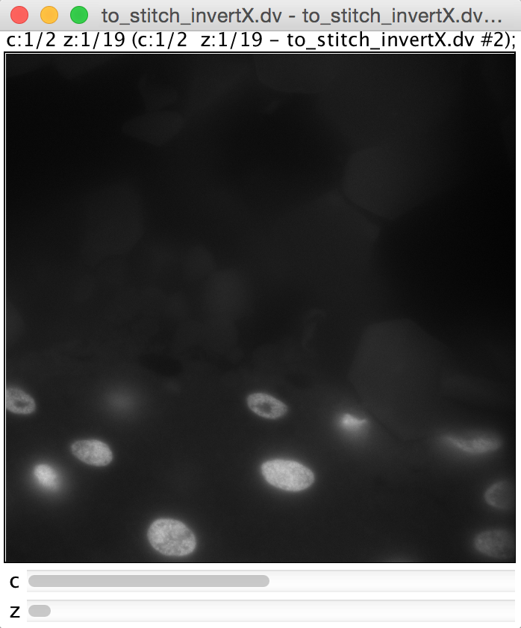
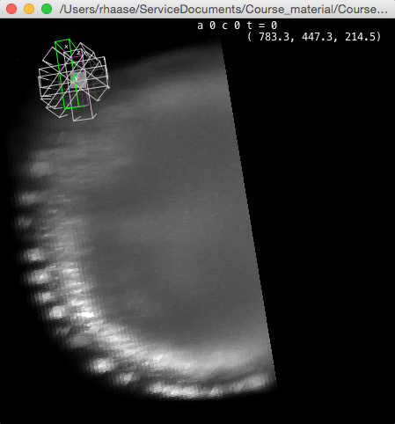
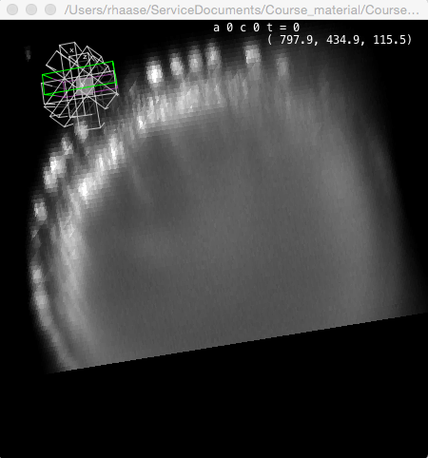
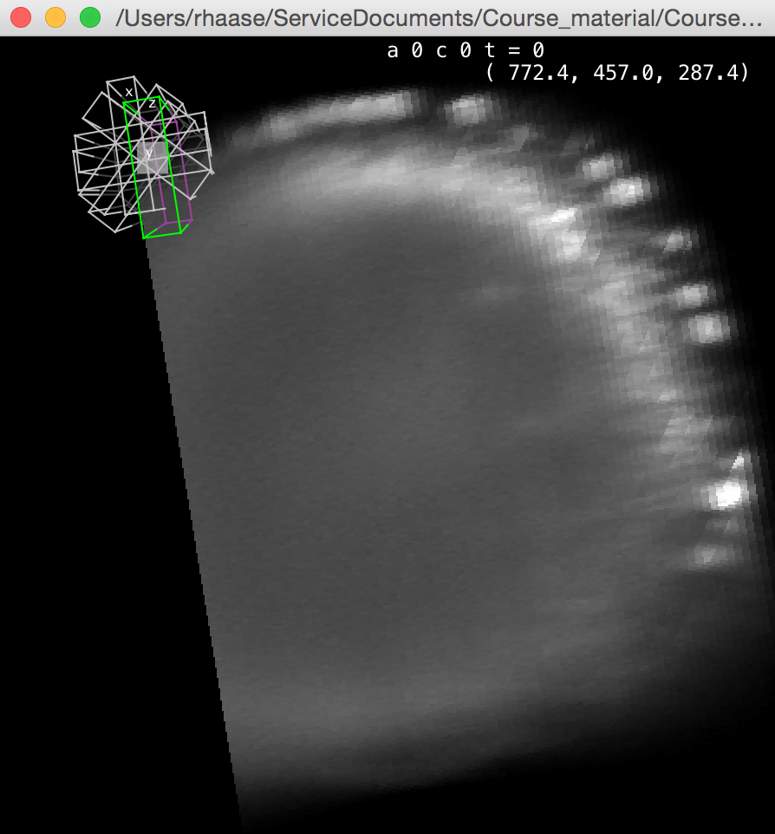
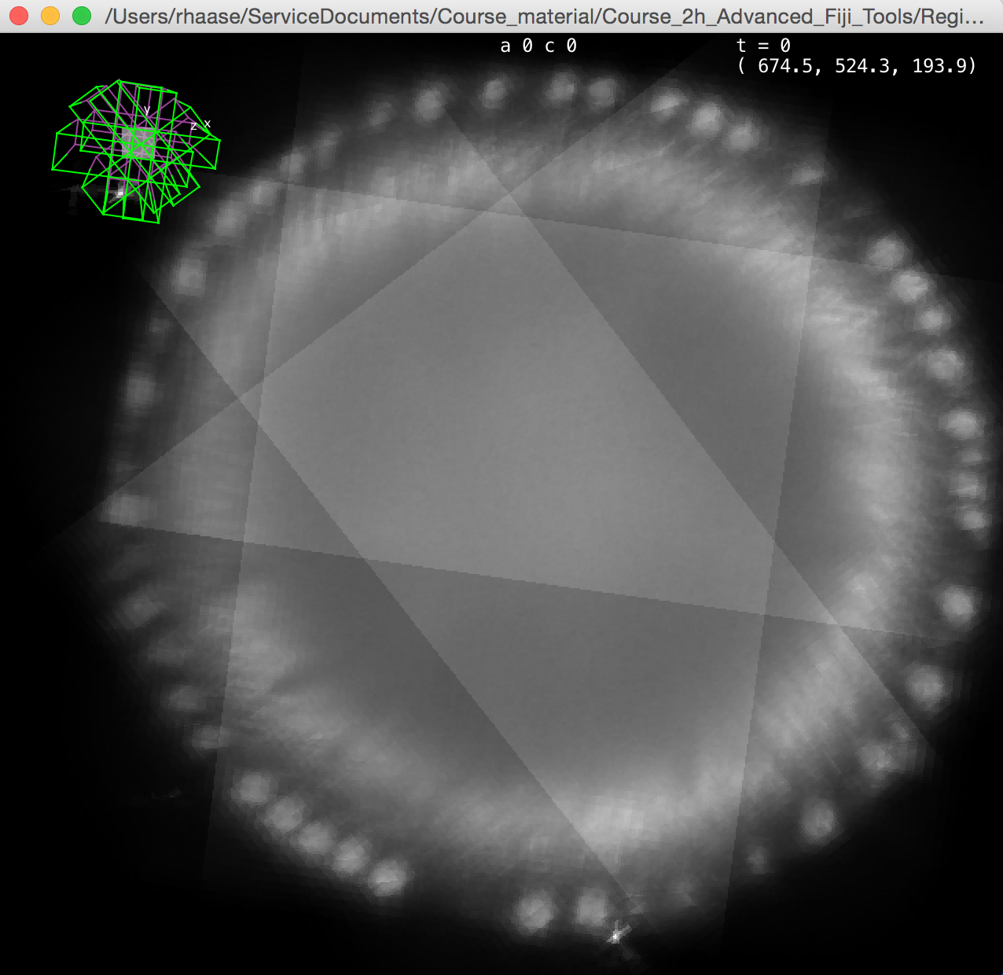

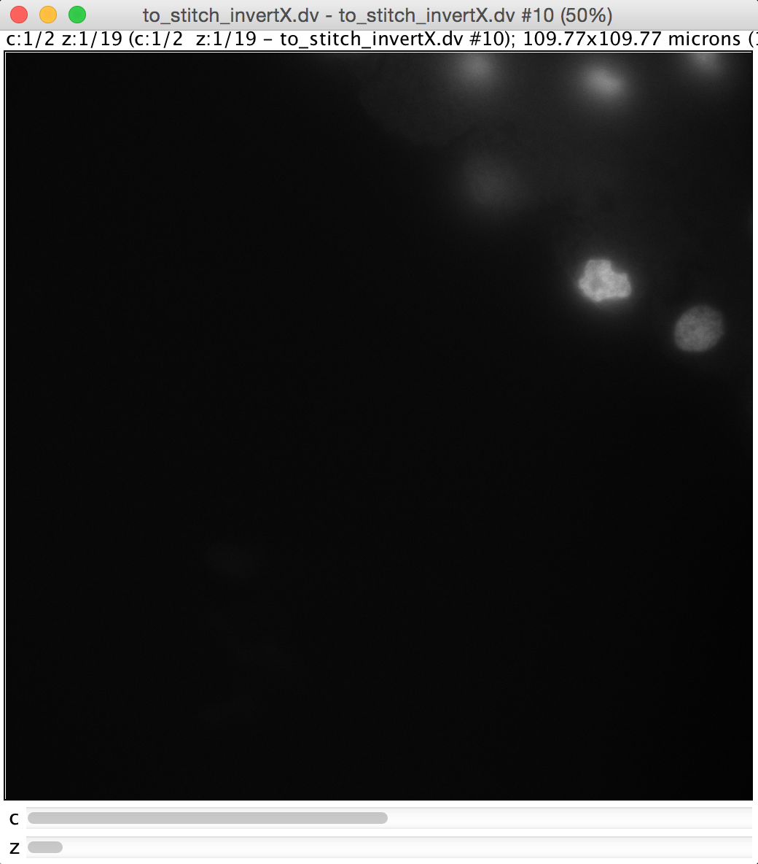
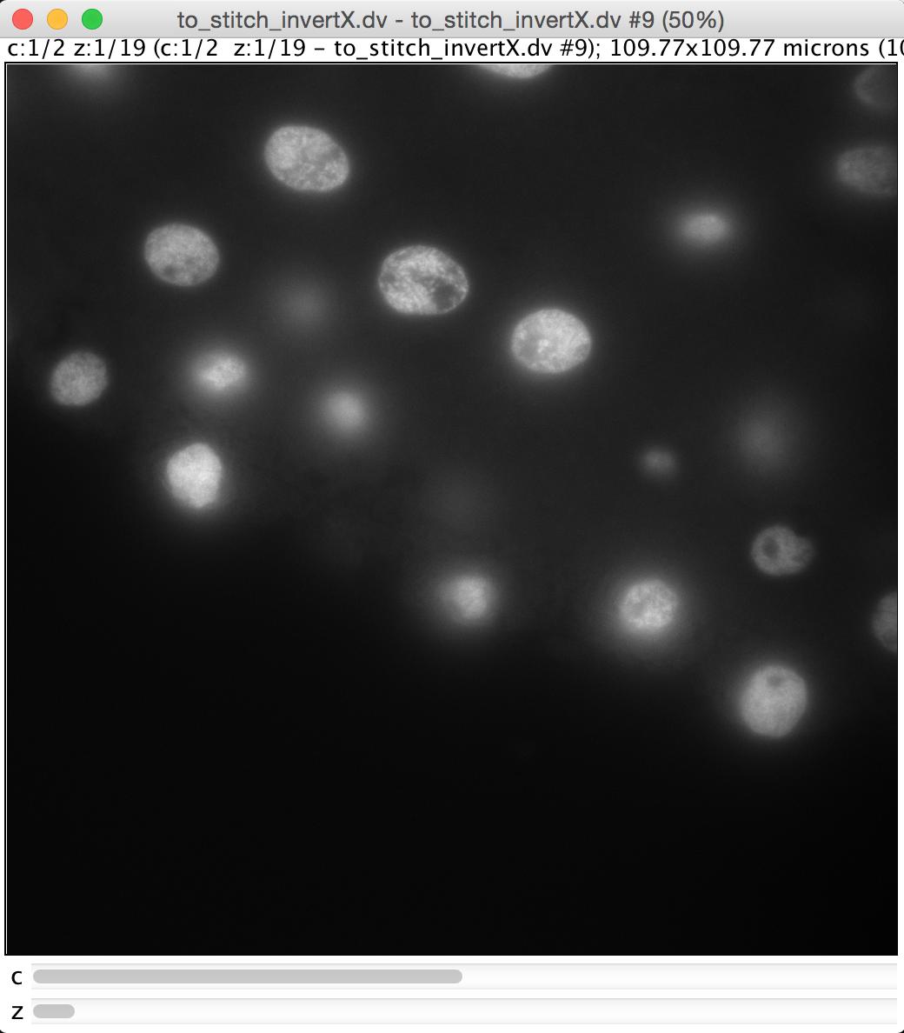
Registration use cases
Use cases
Registration appears in many image pre-processing steps, such as
Chromatic aberration correction
Motion correction
Slice alignment
Stitching
Multiview reconstruction
Original
Image source: http://www.zmescience.com/medicine/gifs-biology-human-body/
Image source: http://imagej.net/Register_Virtual_Stack_Slices
Image source: https://svi.nl/ChromaticAberrationCorrector
Image source: Carine Stapel (Vastenhouw lab)
Image source: https://fiji.sc/ Multiview-Reconstruction

Slide 15
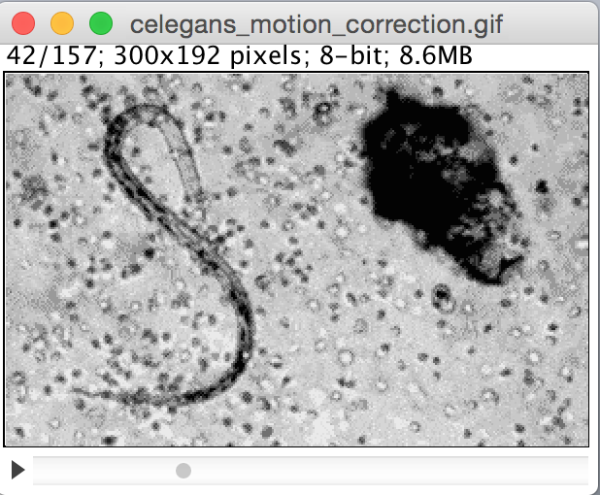
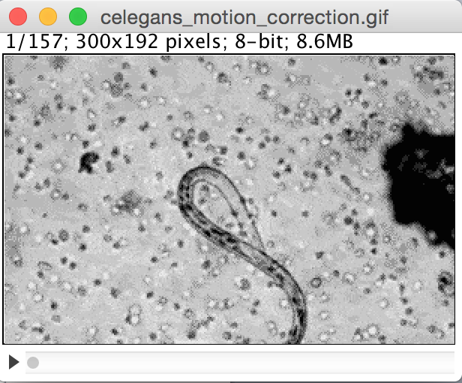
Motion correction using StackReg
Measurements in time sequences
Select a frame, where the investigated object is as centred as possible.
Click menu Plugins > Registration > StackReg
Note: You need the update site “BIG-EPFL” activated in Fiji
Notes:
White blood cells attacking a parasite @ 450x

Slide 16
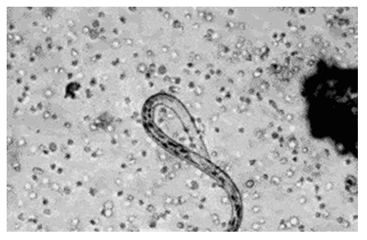
Quiz
If I would like to correct motion in this video, what kind of transformation should I use?
Translation
Rigid
Affine
Image source: http://www.zmescience.com/medicine/gifs-biology-human-body/

Slide 17
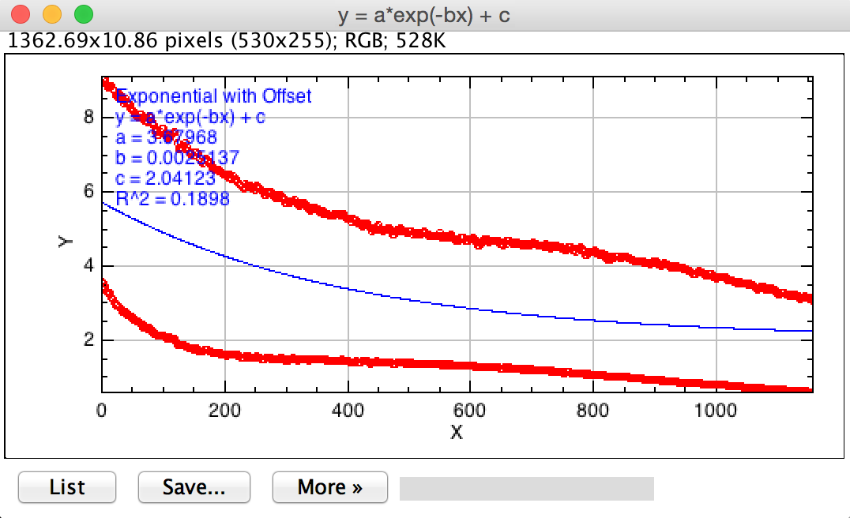
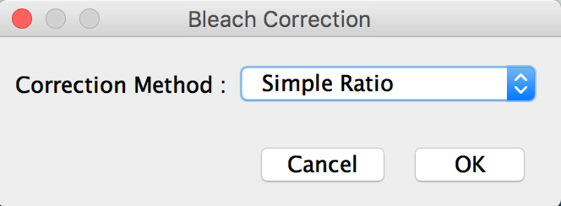
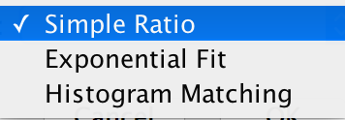
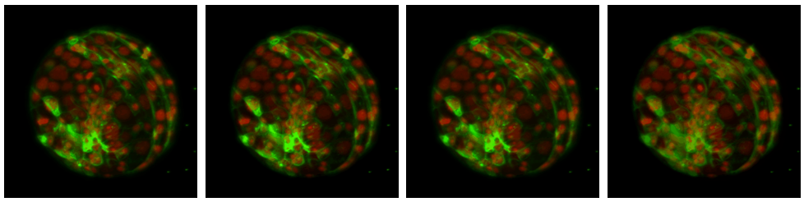
Bleaching correction
Measurements in time sequences
Image > Adjust > Bleach Correction
Original
Simple ratio
Exponential fit
Histogram fit
Image source: Yu-Wen Hsieh, Tomancak lab, MPI CBG

Slide 18
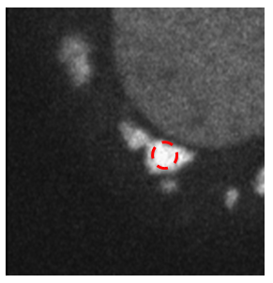
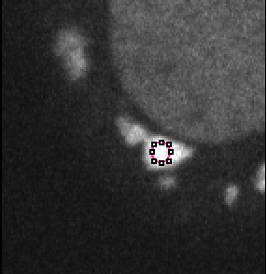
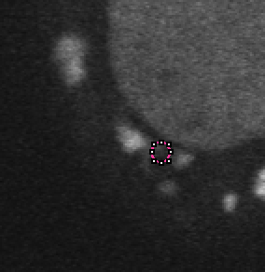
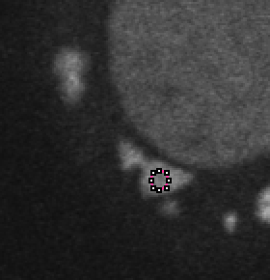
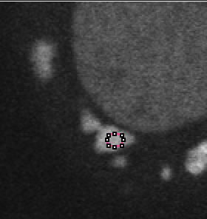
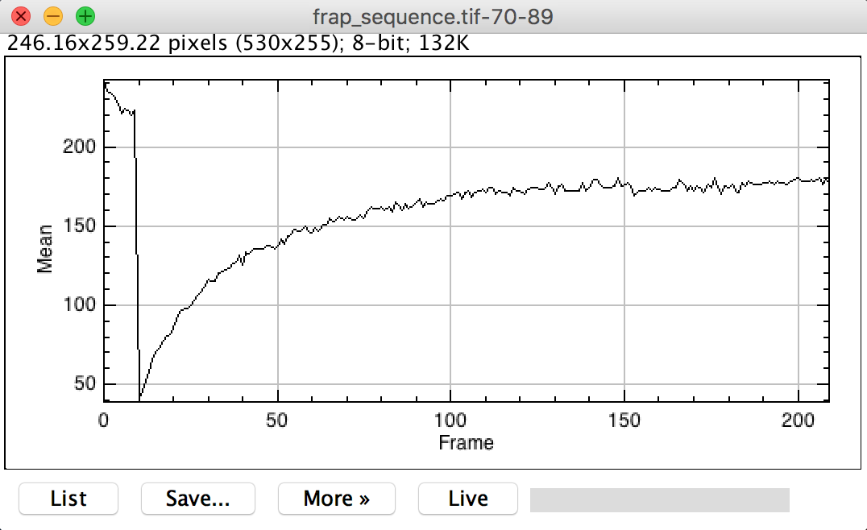
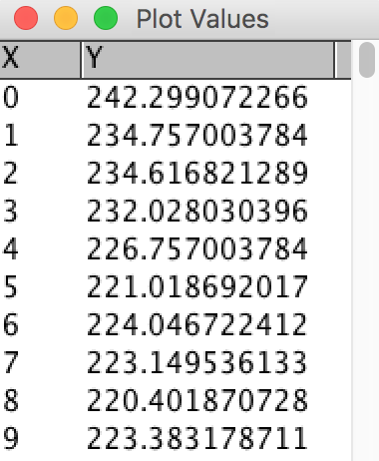
Measuring signal over time
Measurements in time sequences
Image > Stacks > Z-Axis profile

Slide 19
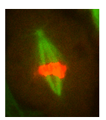
Overview
Measurements in time sequences
Image correction
Image registration
Motion correction
Bleaching correction
Visualisation
Kymography
How to build kymographs
How to interpret kymographs
Visualisation of time sequences in Imaris (Demo)
Tracking
Introduction / Theory
Single particle tracking
Trackmate demo
Exercise

Slide 20
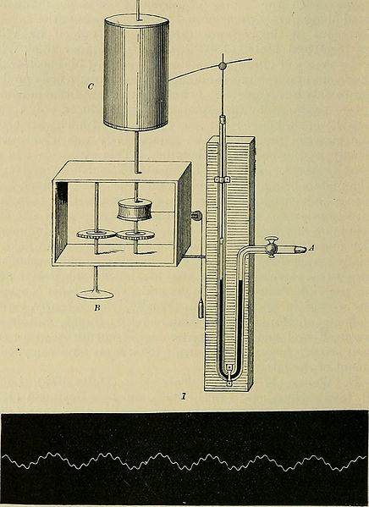
Kymography
Measurements in time sequences
Kymograph (“Wave writer”)
documents water level over time
Kymograph images show signal along a line over time
Source: General physiology; an outline of the science of life (1899), London, Macmillan and co., limited

Slide 21
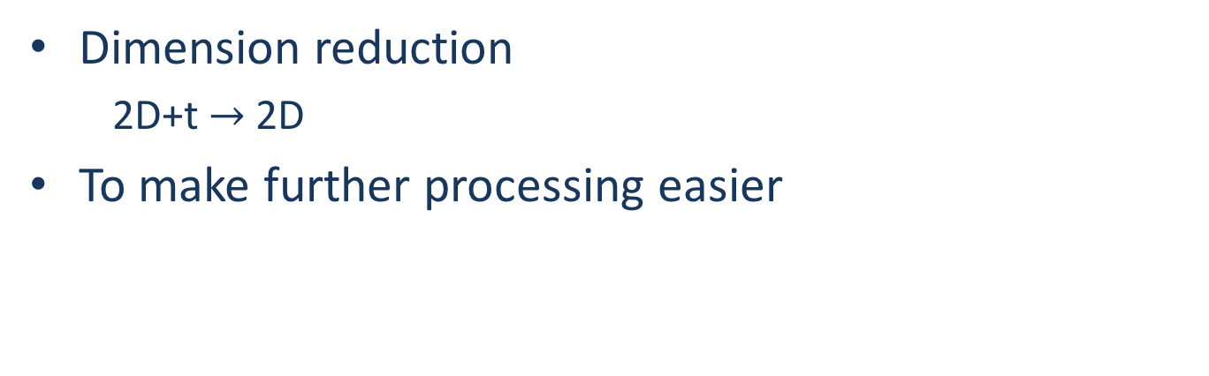
Kymography
Measurements in time sequences
Dimension reduction
2D+t $→$2D
To make further processing easier

Slide 22
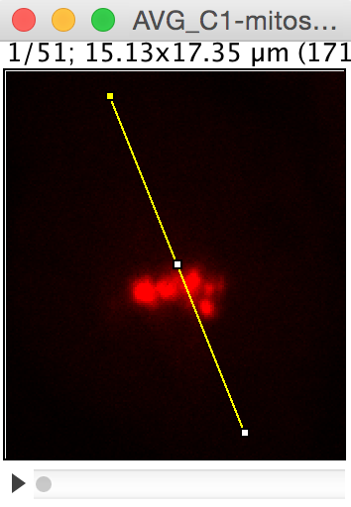
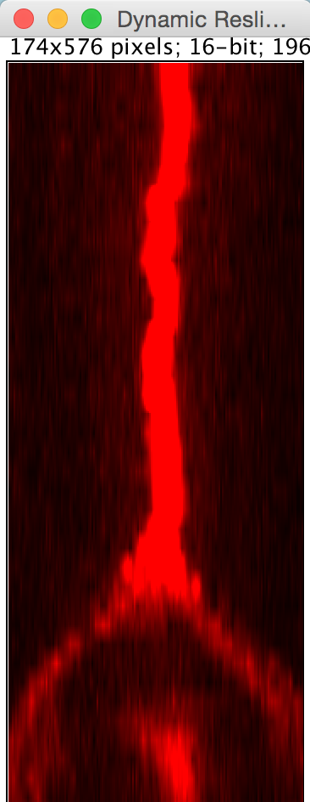
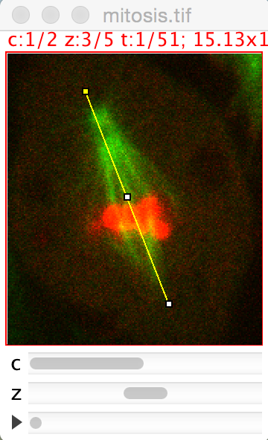
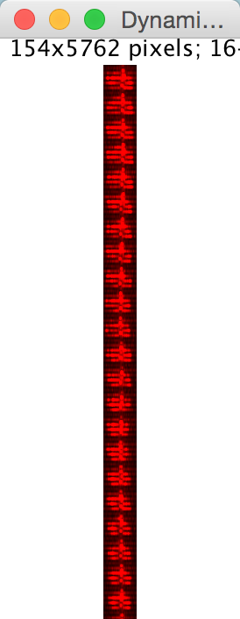
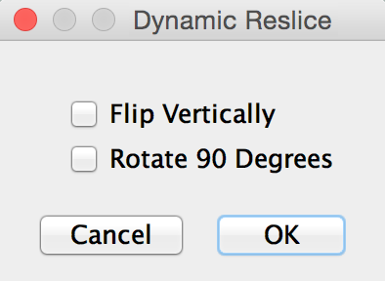
How to draw kymographs
Measurements in time sequences
Do Image > Color > Split Channels and Z-Projection first
Image > Stacks > Dynamic reslice
Keep in mind: You may move the yellow line after reslicing!

Slide 23
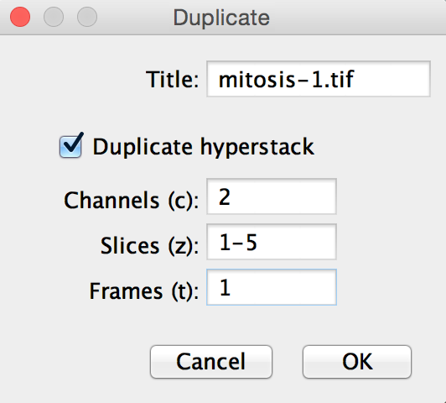





How to draw kymographs
Measurements in time sequences
Alternatively:
Image > Duplicate
Image > Stacks > Dynamic reslice
z
pseudo y
t
pseudo y

Slide 24


Kymograph: Interpretation
Measurements in time sequences
For speed estimation, we need information about
distance and
time
space
space
time
time
How fast are the chromosomes moving?
0.84 microns/second
1.18 microns/second
2.08 pixel/frame

Slide 25




Colour encoding time
Measurements in time sequences
Image > Hyperstack > Temporal-Color code
Image source: Imaris examle image

Slide 26

Demo: Visualising time sequences in Imaris
Measurements in time sequences
DEMO

Slide 27

Demo: Visualising time sequences in Imaris
Measurements in time sequences
Open images, from the Arena by drag and drop

Slide 28


Demo: Visualising time sequences in Imaris
Measurements in time sequences
Edit > Show Display Adjustment

Slide 29

Demo: Visualising time sequences in Imaris
Measurements in time sequences
Go to the Animation pane and add a Frame, marking the video start

Slide 30

Demo: Visualising time sequences in Imaris
Measurements in time sequences
Go to a timepoint where a division is almost happening, add two (!) frames.

Slide 31

Demo: Visualising time sequences in Imaris
Measurements in time sequences
Zoom in and add another frame.

Slide 32

Demo: Visualising time sequences in Imaris
Measurements in time sequences
Continue in time until after the division and add another two (!) frames.

Slide 33

Demo: Visualising time sequences in Imaris
Measurements in time sequences
Zoom out again (or Use the Reset view button) and add another frame.

Slide 34


Demo: Visualising time sequences in Imaris
Measurements in time sequences
After all frames are added, click the Play button to view the video.
Click the Record button to export an AVI or MPG file.

Slide 35
Coffee time!

Slide 36
Overview
Measurements in time sequences
Image correction
Image registration
Motion correction
Bleaching correction
Visualisation
Kymography
How to build kymographs
How to interpret kymographs
Visualisation of time sequences in Imaris (Demo)
Tracking
Introduction / Theory
Single particle tracking
Trackmate demo
Exercise

Slide 37

Introduction
Measurements in time sequences
Tracking: ”following moving objects”
Very active research field
algorithms
applications
High computational effort (complexity)
High performance computing
Goals
Measure track properties (speed, velocity)
Study spatio-temporal relationships
Single particle tracking
Building cell lineages during development
Source: Computer Vision Lab, ETH Zuerich
http://www.vision.ee.ethz.ch/datasets/
Source: Imaris (Bitplane) example image

Slide 38
Introduction
Measurements in time sequences
Cell tracking in a nutshell…
matching
matching
matching
Segmentation
Segmentation
Segmentation
Segmentation
t-2
t=1
t=2
t-1
t
t=3
t+1
99% correct
With courtesy of Florian Jug, MPI CBG

Slide 39
Cell tracking is an algorithmically difficult problem
Measurements in time sequences
Tracking needs many decisions…
Let’s assume we have:
about 1000 objects
500 time points (frames)
How many decisions are to be made?
1000 + 499 * (1000+1000² ) = 499.500.000 (!!!)
With courtesy of Florian Jug, MPI CBG

Slide 40
Cell tracking is an algorithmically difficult problem
Measurements in time sequences
Tracking errors propagate…
t → t + 1: 99% correct
Time points: 100
P(‘correct lineage’) ≈ 0.99⁹⁹ ≈ 37%
Time points: 500
P(‘correct lineage’) ≈ 0.99⁴⁹⁹ ≈ 0.07%
With courtesy of Florian Jug, MPI CBG

Slide 41


Cell tracking – main sources of errors
Measurements in time sequences
Erroneous segmentation
)
How many objects do you see?
1
2
With courtesy of Florian Jug, MPI CBG

Slide 42



Cell tracking – main sources of errors
Measurements in time sequences
Erroneous segmentation
Missed objects (under-segmentation)
Spurious objects (over-segmentation)
With courtesy of Florian Jug, MPI CBG

Slide 43
Cell tracking – main sources of errors
Measurements in time sequences
Erroneous segmentation
Missed objects (under-segmentation)
Spurious objects (over-segmentation)
Erroneous Matching
t
t+1
t+2
With courtesy of Florian Jug, MPI CBG

Slide 44
Terminology
Measurements in time sequences
... just in case you talk to computer science guys
Lineage tree (“graph”)
“Track”
“Edge”
“Node” / “Spot”
“Leaf”
“Root”

Slide 45











Manual single particle tracking
Measurements in time sequences
Use the point tool to locate one particle in different (subsequent) time points.
Menu Edit > Options > Point Tool...

Slide 46

Manual single particle tracking
Measurements in time sequences
... then just use other scientific software to do your analysis

Slide 47




Manual single particle tracking
Measurements in time sequences
Use the multi-point tool to locate one particle in different (subsequent) time points.

Slide 48

Exercise: speed measurements
Measurements in time sequences
Measure the speed of this one particular particle.
Do we have time for that?
30 min
no

Slide 49
Exercise
Measurements in time sequences
Speed is distance travelled divided by time taken
Do we have time for that?
no

Slide 50

Trackmate – your buddy for everyday tracking
Measurements in time sequences
DEMO

Slide 51

Trackmate
Measurements in time sequences

Slide 52



Trackmate: spot detection
Measurements in time sequences
Use and configure the LoG detector to get a good detection
Use the preview button!

Slide 53




Trackmate: Spot detection
Measurements in time sequences

Slide 54



Trackmate: tracking
Measurements in time sequences
The ”Simple LAP tracker” is fast and good but
The “LAP tracker” supports splitting and merging

Slide 55



Trackmate: tracking
Measurements in time sequences
The ”Simple LAP tracker” is fast and good, but:
The “LAP tracker” supports splitting and merging

Slide 56


Trackmate: filtering
Measurements in time sequences
Track filters allow for removing e.g. super short tracks

Slide 57


Trackmate: lineage inspection
Measurements in time sequences
Use the TrackScheme to inspect lineages

Slide 58

Trackmate: lineage inspection
Measurements in time sequences
Select tracks or single spots

Slide 59


Trackmate: Add a spot
Measurements in time sequences
Press the A key (“Add”) to add a new spot at some position.
Press Q and E to increase or decrease the size of the spot.

Slide 60




Trackmate: Add a linked spot
Measurements in time sequences
Select a spot by clicking on it
Activate linking mode by pressing SHIFT-L
Move forward in time and press A

Slide 61



Trackmate: Link spots/tracks
Measurements in time sequences
Select spot A in timepoint t by clicking it
Go to timepoint t+1 and select spot B while holding SHIFT
Press L to link both spots

Slide 62



Trackmate: Move spots
Measurements in time sequences
Hold the SPACE key while hovering over a spot. Move the mouse while holding the key.

Slide 63

Remove tracks manually
Measurements in time sequences
Hover over a spot and press the D key (“Delete”)
Delete spots from the lineage view

Slide 64


Trackmate: lineage curation
Measurements in time sequences
Cut a track where spots were wrongly connected.

Slide 65




Trackmate: lineage curation
Measurements in time sequences
Wait until you see and then drag and drop to make a new connection.
DRAG
DROP

Slide 66



Trackmate: Plotting
Measurements in time sequences
Plot measurements using Trackmate or export all measurements.

Slide 67
Trackmate: Save tracks!
Measurements in time sequences
Don’t forget to save your tracks!
Save it after every important step – just in case ;-)

Slide 68
Summary
Measurements in time sequences
Translation, rigid, affine registration
Draw and interpret Kymographs
Automatic tracking and manual curation

Slide 69


Exercise
Measurements in time sequences
File > Open Samples > Tracks for Trackmate
Measure the length and mean velocity of the longest track
Explain the measurements

